Slide 1
Pattern Generation for a sustainable One-Dimensional Stock Cutting with limited usage of unique Standard Lengths and unique Patterns for minimizing overall Trim Losses and Cost
Santanu Banerjee^{1,2} , Aravind Asokan², Archana Bharatee², Snegha A^{2,3}
¹ Department of Industrial and Systems Engineering (ISE), Indian Institute of Technology Kharagpur (IITKGP), India
² SenseiAlgo
³ Centre for Machine Intelligence and Data Science (C-MInDS), Indian Institute of Technology Bombay (IITB), India
E-mails: santanu@b2boptimize.ai, aravind.a@b2boptimize.ai, archana.b@b2boptimize.ai, snegha.a@b2boptimize.ai

Slide 2
Pattern Generation for a sustainable One-Dimensional Stock Cutting with limited usage of unique Standard Lengths and unique Patterns for minimizing overall Trim Losses and Cost
Presented by:~
Santanu Banerjee,
MS and SRF,
Department of Industrial and Systems Engineering (ISE), Indian Institute of Technology Kharagpur (IITKGP), India
E-mail: santanu@kgpian.iitkgp.ac.in

Slide 3
Introduction
The global industrial waste generated in 2011 was 9.2 billion tons [Vignesh et. al., 2021]. In comparison to developed countries, which collected 90% of this waste, developing countries like India were able to recycle less than 50% of it, thereby creating more safety threats from the extreme toxic wastes.
A major optimization problem of minimizing waste generation in manufacturing processes is the classical cutting-stock problem (CSP as introduced in [Eisemann, 1957]). The one-dimensional CSP focuses on minimizing the trim losses during cutting of large rolls of a material into smaller cuts. In their original problem, the number of types of final cuts were four which is a small number due to which they could use all combinations of the cuts to find the best optimal solution
Managing wastage at its source, by minimizing generation, recycling, and prevention of proliferation of toxic content during waste management is essential.

Slide 4
Literature Review
The term “cutting-stock” was introduced in [Gilmore and Gomory, 1961] where they approached the CSP utilizing column generation considering multiple standard length usage and many required final-cuts.
An exact solution methodology of the CSP is discussed in [Degraeve and M. Peeters, 2003] which is able to solve industrial sizes of the CSP within realistic time.
A one-dimensional multiple stock sizes cutting stock problem (1DMSSCSP) is discussed in [Cui et. al., 2015] where they develop a pattern set generation algorithm, which outperforms some heuristics.
In [Mellouli et. al., 2019] the authors describe a multi-objective optimization problem for the two-dimensional CSP with the other objective of minimizing machine set-up times. This is similar to our consideration of minimizing the number of unique pattern usages as described subsequently. The process of generating an initial set of good representative patterns is investigated which is then be used to solve the classical CSP; considering many final-cuts to be obtained from multiple standard lengths, further minimizing the total number of unique standard lengths and combinations being used.

Slide 5
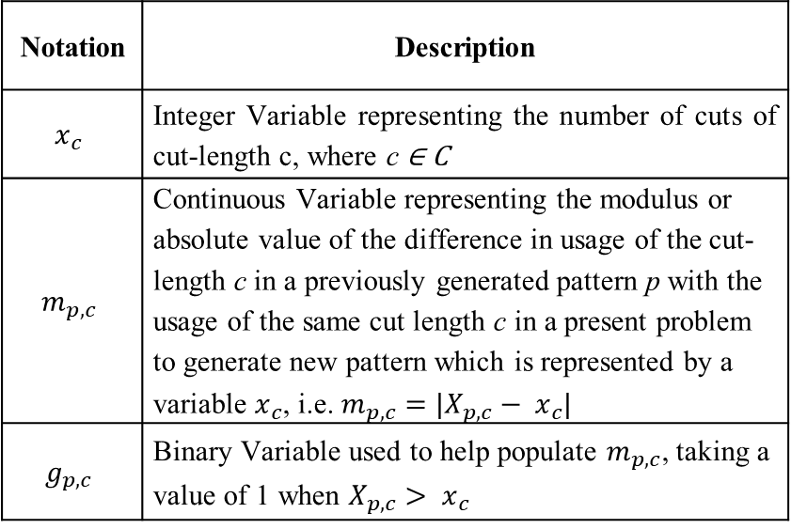
Pattern Generation for the 1DMSSCSP
Pattern-sets for each of the standard lengths is generated; each unique new pattern generation has the objective of minimizing the waste or trim-loss.
Table 1: Sets and Parameters Used
Table 2: Variable Definitions for the Pattern Generation Problem
Notation | Description
C | Set of cut-lengths
L | Set of standard lengths
R(c) | Requirements of the cut-length c, where c ∈ C
N | An user-input for the number of Patterns to be generated, in addition to Patterns generated whence each unique cut-length is mandatorily used once. (For each standard length)
P(l) | At any place whenever this set is defined in this paper, it represents the set of all patterns generated previously for the standard length l, where l ∈ L
X_{p,c} | This parameter progressively stores the patterns generated for future comparison to enforce uniqueness during subsequent pattern generation . It represents the number of cut-lengths of dimension c, (c ∈ C), being present in the previously generated pattern p, where p ∈ P(l); (or p ∈ P as mentioned later)
M | A very big number
Notation | Description
$$x_{c}$$ | Integer Variable representing the number of cuts of cut-length c, where c ∈ C
$$m_{p,c}$$ | Continuous Variable representing the modulus or absolute value of the difference in usage of the cut-length c in a previously generated pattern p with the usage of the same cut length c in a present problem to generate new pattern which is represented by a variable $x_{c}$, i.e. $m_{p,c}=|X_{p,c}− x_{c}|$
$$g_{p,c}$$ | Binary Variable used to help populate $m_{p,c}$, taking a value of 1 when $X_{p,c}> x_{c}$

Slide 6
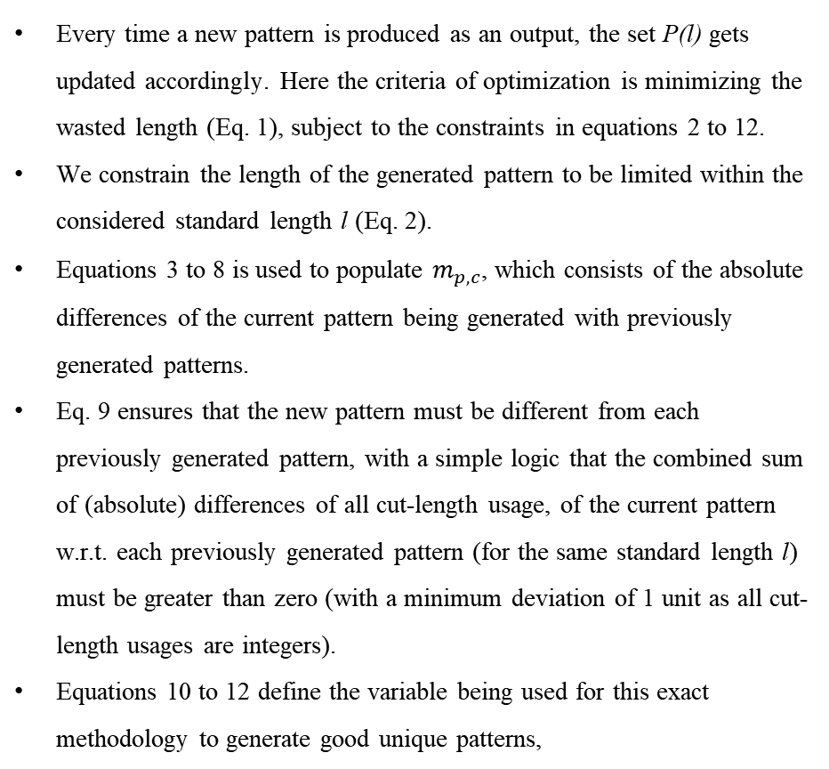
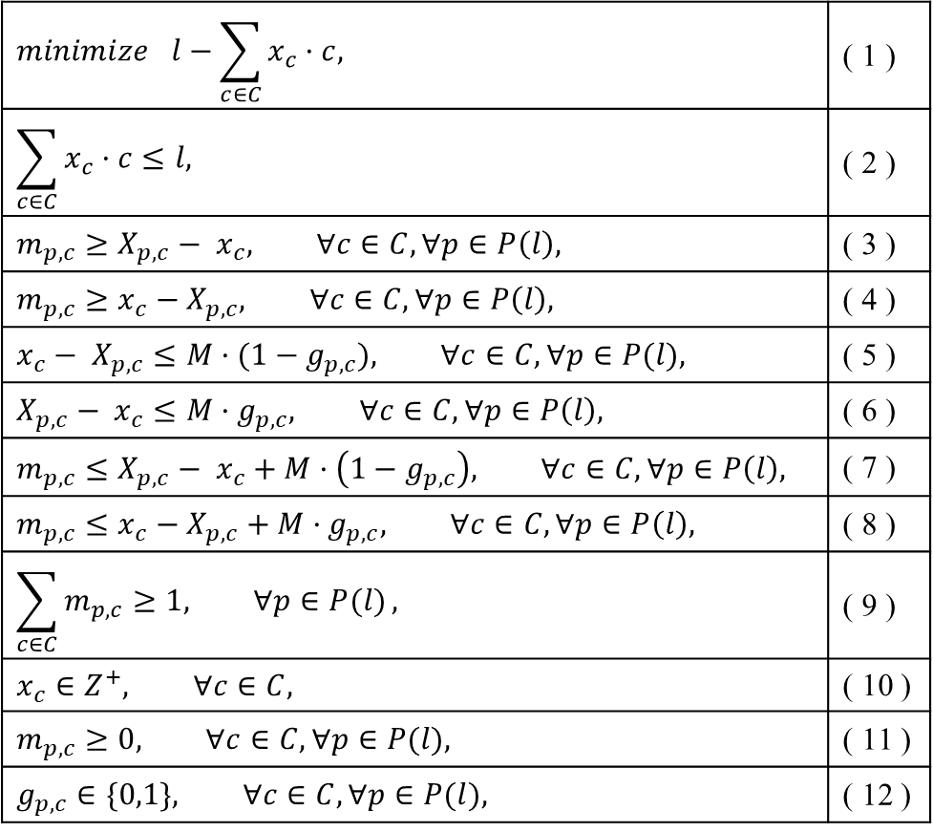
To generate the pattern set for each standard length l, where l ∈ L, the following exact approach (equations 1 to 12) was used N times, generating the best set of N patterns for each standard length l.
$$minimize l−\sum_{c∈C}{x_{c}·c, }$$ | ( 1 )
$$\sum_{c∈C}{x_{c}·c≤l, }$$ | ( 2 )
$$m_{p,c}≥X_{p,c}− x_{c}, ∀c∈C, ∀p∈P\left(l\right),$$ | ( 3 )
$$m_{p,c}≥x_{c}−X_{p,c}, ∀c∈C, ∀p∈P\left(l\right),$$ | ( 4 )
$$x_{c}− X_{p,c}≤M·(1−g_{p,c}), ∀c∈C, ∀p∈P(l),$$ | ( 5 )
$$X_{p,c}− x_{c}≤M·g_{p,c}, ∀c∈C, ∀p∈P\left(l\right),$$ | ( 6 )
$$m_{p,c}≤X_{p,c}− x_{c}+M·\left(1−g_{p,c}\right), ∀c∈C, ∀p∈P\left(l\right),$$ | ( 7 )
$$m_{p,c}≤x_{c}−X_{p,c}+M·g_{p,c}, ∀c∈C, ∀p∈P\left(l\right),$$ | ( 8 )
$$\sum_{c∈C}{m_{p,c}≥1, ∀p∈P(l)},$$ | ( 9 )
$$x_{c}∈Z^{+}, ∀c∈C,$$ | ( 10 )
$$m_{p,c}≥0, ∀c∈C, ∀p∈P(l),$$ | ( 11 )
$$g_{p,c}∈\{0,1\}, ∀c∈C, ∀p∈P(l),$$ | ( 12 )
Every time a new pattern is produced as an output, the set P(l) gets updated accordingly. Here the criteria of optimization is minimizing the wasted length (Eq. 1), subject to the constraints in equations 2 to 12.
We constrain the length of the generated pattern to be limited within the considered standard length l (Eq. 2).
Equations 3 to 8 is used to populate $m_{p,c}$, which consists of the absolute differences of the current pattern being generated with previously generated patterns.
Eq. 9 ensures that the new pattern must be different from each previously generated pattern, with a simple logic that the combined sum of (absolute) differences of all cut-length usage, of the current pattern w.r.t. each previously generated pattern (for the same standard length l) must be greater than zero (with a minimum deviation of 1 unit as all cut-length usages are integers).
Equations 10 to 12 define the variable being used for this exact methodology to generate good unique patterns,

Slide 7
Explanation with an Example:
 | Standard Length = 8
 | Cut Lengths
 | 2
 | 3
 | 4
 | 5
 | Standard Length = 6
Non-zero wastes generated from these patterns

Slide 8
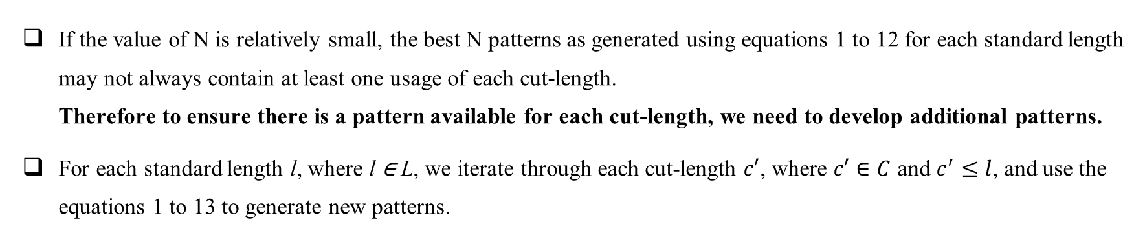
If the value of N is relatively small, the best N patterns as generated using equations 1 to 12 for each standard length may not always contain at least one usage of each cut-length. Therefore to ensure there is a pattern available for each cut-length, we need to develop additional patterns.
For each standard length l, where l ∈ L, we iterate through each cut-length $c′$, where $c′∈C$ and $c^{′}≤l$, and use the equations 1 to 13 to generate new patterns.
$$x_{c′}≥1, ∀c^{′}∈C, c^{′}≤l,$$ | ( 13 )
During this second set of pattern generation for each standard length and each cut-length, it may so happen that no new pattern may be found (as they may have already been considered in the first set of pattern generation without the mandatory usage of each cut-length).
We therefore generate about N+|C| patterns for each standard length to be used for the classical CSP with WCSP minimization approach.

Slide 9
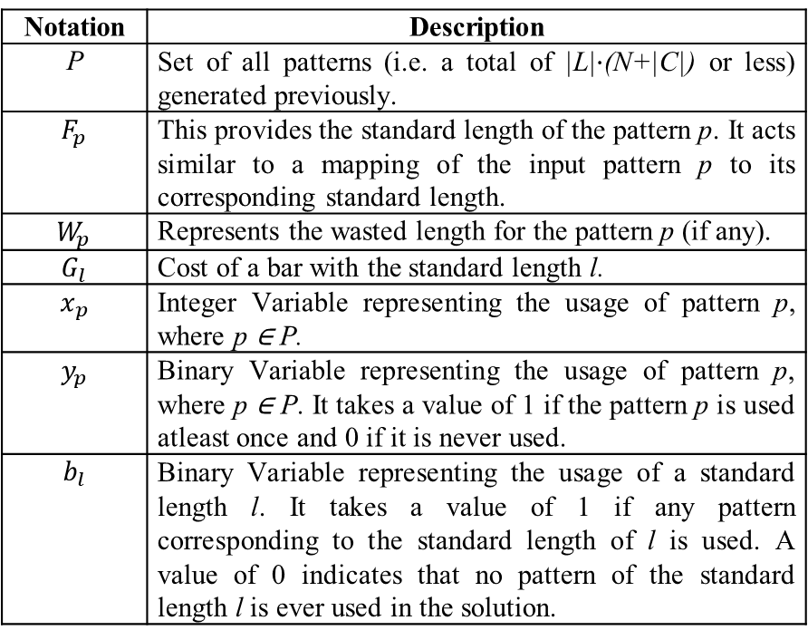
Waste-Cost-Standards-Patterns (WCSP) Sequential Minimization Approach to CSP
The step-wise minimization of total Waste generated, total Cost incurred, total unique Standard Lengths used in the solution, and the total unique Patterns usage allows a holistic overview of the dimensions of optimization necessary for such a problem.
Table 3: Sets, Parameters and Variable Definition for the Stock Cutting Problem
Notation | Description
P | Set of all patterns (i.e. a total of |L|$·$(N+|C|) or less) generated previously.
$$F_{p}$$ | This provides the standard length of the pattern p. It acts similar to a mapping of the input pattern p to its corresponding standard length.
$$W_{p}$$ | Represents the wasted length for the pattern p (if any).
$$G_{l}$$ | Cost of a bar with the standard length l.
$$x_{p}$$ | Integer Variable representing the usage of pattern p, where p ∈ P.
$$y_{p}$$ | Binary Variable representing the usage of pattern p, where p ∈ P. It takes a value of 1 if the pattern p is used atleast once and 0 if it is never used.
$$b_{l}$$ | Binary Variable representing the usage of a standard length l. It takes a value of 1 if any pattern corresponding to the standard length of l is used. A value of 0 indicates that no pattern of the standard length l is ever used in the solution.
The primary objective of the discussed CSP is waste-minimization with a subsequent objectives of cost minimization and unique usages of Standard Lengths and Patterns respectively, which is optimized using a WCSP sequential minimization approach.

Slide 10
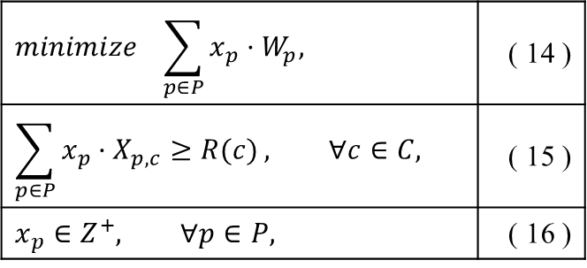
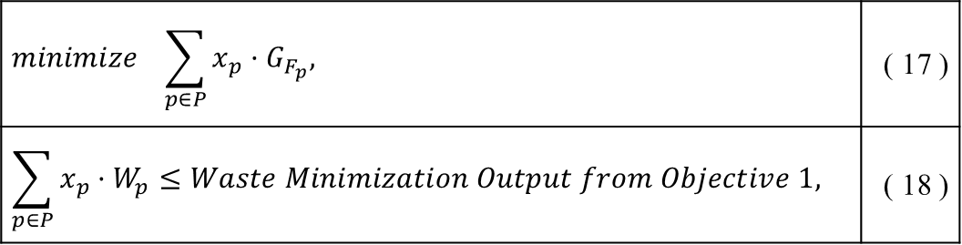
Waste-Cost-Standards-Patterns (WCSP) Sequential Minimization Approach to CSP (contd.)
Waste Minimization CSP as Objective 1
Cost Minimization CSP as Objective 2
The Waste Minimization CSP as Objective 1 is defined using equations 14 to 16, where the objective function in Eq. 14 minimizes the total waste generated for each pattern used, satisfying the necessary cut-length requirements using Eq. 15.
The Cost Minimization CSP as Objective 2 is defined using equations 15 to 18, where the cost minimization objective is described using Eq. 17, and the previous objective 1 (Eq. 17) is replaced as a constraint in Eq. 18.
$$minimize \sum_{p∈P}{x_{p}·W_{p}, }$$ | ( 14 )
$$\sum_{p∈P}{x_{p}·X_{p,c}≥R(c)}, ∀c∈C,$$ | ( 15 )
$$x_{p}∈Z^{+}, ∀p∈P,$$ | ( 16 )
$$minimize \sum_{p∈P}{x_{p}·G_{F_{p}}, }$$ | ( 17 )
$$\sum_{p∈P}{x_{p}·W_{p}}≤Waste Minimization Output from Objective 1,$$ | ( 18 )

Slide 11
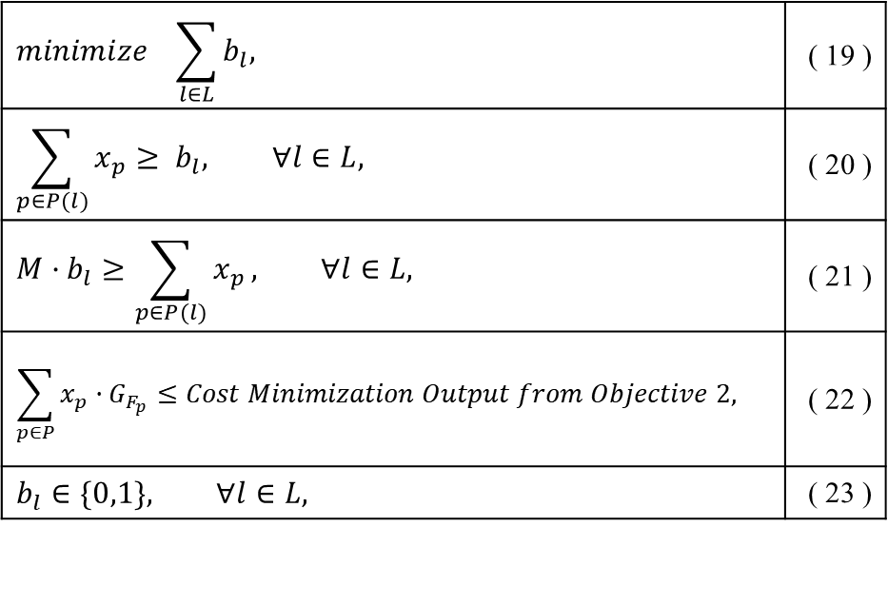
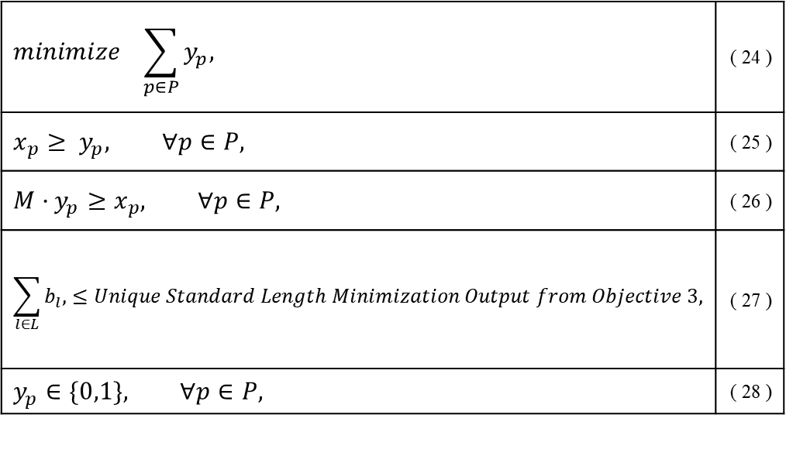
Minimization of unique Standard Length usages as Objective 3
Minimize Unique Patterns Usage as Objective 4
The minimization of unique Standard Length usages as Objective 3 is defined using equations 15 to 23, excluding Eq. 17. The previous Objective 2 minimization function (Eq. 17) is replaced as a constraint in this problem as Eq. 22. The present objective function of minimizing unique Standard Lengths being used is described in Eq. 19. Equations 20 and 21 are used to populate the binary variable (Eq. 23) representing at least a single usage of respective standard length.
The final CSProblem as Objective 4 is described using equations 15 to 28, excluding equations 17 and 19. Equation 24 minimizes the unique patterns which are used in the solution; where equations 25 and 26 populate the binary variable (described in Eq. 28) representing usage of a pattern (taking a value of 0 if the respective pattern is not used in the solution). The objective function of Eq. 19 is replaced as the constraint of Eq. 27, with the constraining bound as the objective function value from the previous Objective 3.
$$minimize \sum_{l∈L}{b_{l}, }$$ | ( 19 )
$$\sum_{p∈P(l)}{x_{p}}≥ b_{l}, ∀l∈L,$$ | ( 20 )
$$M·b_{l}≥\sum_{p∈P(l)}{x_{p}}, ∀l∈L,$$ | ( 21 )
$$\sum_{p∈P}{x_{p}·G_{F_{p}}}≤Cost Minimization Output from Objective 2,$$ | ( 22 )
$$b_{l}∈\{0,1\}, ∀l∈L,$$ | ( 23 )
$$minimize \sum_{p∈P}{y_{p}, }$$ | ( 24 )
$$x_{p}≥ y_{p}, ∀p∈P,$$ | ( 25 )
$$M·y_{p}≥x_{p}, ∀p∈P,$$ | ( 26 )
$$\sum_{l∈L}{b_{l}, }≤Unique Standard Length Minimization Output from Objective 3,$$ | ( 27 )
$$y_{p}∈\{0,1\}, ∀p∈P,$$ | ( 28 )

Slide 12
Dataset, Results and Discussion
We compare the performance of our deterministic heuristic by developing computational instances which may be found in the online dataset available on GitHub.
I n s t a n c e | Parameters of the Instance (Input) |  |  | Heuristic Parameter [N] | Total Patterns Generat-ed [P] | Obj. 1 | Obj. 2 | Obj. 3 | Obj. 4 | Total Time taken for the Pattern Generations and all Objective Computations (seconds) | Waste %-age #
 | No. of unique Cut-Lengths | No. of available Unique Standard Lengths | Total Length of all require-ments |  |  | Min. Total Waste | Min. Total Cost | Min. unique Standard length usage | Min. unique Pattern usage
1 | 24 | 6 | 19346.3 | 50 | 418 | 28.254 | 1269.77 | 3 | 17 | 313.1 | 0.146
2 | 24 | 5 | 20408.2 | 50 | 370 | 32.610 | 788.87 | 5 | 21 | 241.9 | 0.160
3 | 24 | 5 | 8727.8 | 25 | 193 | 179.034 | 523.01 | 5 | 20 | 100.1 | 2.051
4 | 24 | 6 | 9789.7 | 30 | 299 | 31.865 | 752.69 | 4 | 16 | 145.8 | 0.325
5 | 32 | 4 | 14898.1 | 50 | 320 | 14.562 | 1148.08 | 3 | 24 | 326.4 | 0.098
6 | 24 | 4 | 19134.1 | 40 | 230 | 44.856 | 1144.78 | 2 | 19 | 156.9 | 0.234
7 | 24 | 5 | 10001.8 | 30 | 270 | 257.547 | 616.85 | 4 | 18 | 61.8 | 2.575
8 | 16 | 3 | 6836.0 | 55 | 200 | 27.762 | 397.10 | 3 | 11 | 63.6 | 0.406
9 | 18 | 3 | 29580.7 | 45 | 173 | 626.898 | 1570.42 | 2 | 16 | 48.1 | 2.119
10 | 48 | 11 | 29136.0 | 50 | 1045 | 5.232 | 1403.08 | 7 | 38 | 781.3 | 0.018
# Waste % is calculated as (Objective 1 / Total Length of all requirements) * 100

Slide 13
Conclusion
It is necessary for proper implementation of scrap-optimization within industrial processes to help nullify manufacturing wastes. The discussed methodology of prior pattern-set generation has great potential to be when implemented in real processes, especially since the total waste generated is near to zero for each of the patterns.
The discussed method of WCSP approach takes into consideration the priority of minimizing wastage above the optimization criteria of cost reduction which highlights the shifting trend in industrial decision making towards a more sustainable outlook. This is especially promising in terms of the current situation of actual implementation of sustainable practices within industries in the developing nations.
As a future direction, the WCSP approach should be extended to further variants of pattern generation techniques, especially utilizing newer meta-heuristics for the problem; and extend this approach to solve the 2DMSSCSP.

Slide 14
References
S. Singh and C. M. Hussain, "Chapter Three - Zero waste manufacturing," in Concepts of Advanced Zero Waste Tools, C. M. Hussain, Ed., Elsevier, 2021, pp. 45-67.
K. Vignesh, S. Rajadesingu and K. D. Arunachalam, "Chapter Four - Challenges, issues, and problems with zero-waste tools," in Concepts of Advanced Zero Waste Tools, C. M. Hussain, Ed., Elsevier, 2021, pp. 69-90.
K. Eisemann, "The Trim Problem," Management Science, vol. 3, no. 3, pp. 279-284, 1957.
P. C. Gilmore and R. E. Gomory, "A Linear Programming Approach to the Cutting-Stock Problem," Operations Research, vol. 9, no. 6, pp. 849-859, 1961.
P. C. Gilmore and R. E. Gomory, "A Linear Programming Approach to the Cutting Stock Problem-Part II," Operations Research, vol. 11, no. 6, pp. 863-888, 1963.
Z. Degraeve and M. Peeters, "Optimal Integer Solutions to Industrial Cutting-Stock Problems: Part 2, Benchmark Results," INFORMS Journal on Computing, vol. 15, no. 1, pp. 58-81, 2003.
Z. Degraeve and L. Schrage, "Optimal Integer Solutions to Industrial Cutting Stock Problems," INFORMS Journal on Computing, vol. 11, no. 4, pp. 406-419, 1999.
H. Dyckhoff, "A New Linear Programming Approach to the Cutting Stock Problem," Operations Research, vol. 29, no. 6, pp. 1092-1104, 1981.
H. Gehring, T. Gal and W. Rödder, "Produktions-und Lagerbestandsplanung mit einem mehrstufigen Produktionsmodell," in Papers of the 8th DGOR Annual Meeting/Vorträge der 8. DGOR Jahrestagung, Heidelberg, 1979.
K. Heicken and W. König, "Integration eines heuristisch-optimierenden Verfahrens zur Lösung eines eindimensionalen Verschnittproblems in einem EDV-gestützten Produktionsplanungs- und-Steuerungssystem," Operations-Research-Spektrum, vol. 1, no. 4, pp. 251-259, 1 December 1980.
S. M. Suliman, "Pattern generating procedure for the cutting stock problem," International Journal of Production Economics, vol. 74, no. 1, pp. 293-301, 2001.
G. Ben Lagha, N. Dahmani and S. Krichen, "Particle swarm optimization approach for resolving the cutting stock problem," in 2014 International Conference on Advanced Logistics and Transport (ICALT), 2014.
Y. Cui, Y.-P. Cui and Z. Zhao, "Pattern-set generation algorithm for the one-dimensional multiple stock sizes cutting stock problem," Engineering Optimization, vol. 47, no. 9, pp. 1289-1301, 2015.
A. Mellouli, R. Mellouli and F. Masmoudi, "An Innovative Genetic Algorithm for a Multi-Objective Optimization of Two-Dimensional Cutting-Stock Problem," Applied Artificial Intelligence, vol. 33, no. 6, pp. 531-547, 2019.
J. Kallrath, S. Rebennack, J. Kallrath and R. Kusche, "Solving real-world cutting stock-problems in the paper industry: Mathematical approaches, experience and challenges," European Journal of Operational Research, vol. 238, no. 1, pp. 374-389, 2014.

Slide 15
Thank You ~ for your kind attention!

